Slide 1
HHU@ BTW 2017 Data Science Challenge SDSC17
BTW 2017 Data Science Challenge SDSC17, 07.03.2017 Stuttgart
Alexander Askinadze & Matthias Liebeck
Heinrich-Heine-Universität Düsseldorf
{askinadze, liebeck}@cs.uni-duesseldorf.de

Slide 2
Outline
Introduction
Analysis & Statistics
Visualization
„How to travel safely in NYC?“
Conclusion & Future Work

Slide 3
Introduction

Slide 4
Outline
Objective of the challenge: Given a data set about car accidents in New York City, the participants were asked to explore and analyze the data set. Some questions and tasks were suggested, like for instance:
  Where are dangerous spots?
  Where are accident-free spots?
  Visualize the data
  Create an animation of the development over time
  Descriptive statistics and correlations, such as:
    What types of accidents occur?
    Are there connections between accidents and large public events?
    What factors influence accidents?
Main question: How large is the potential for avoiding accidents?

Slide 5
Dataset
The primary dataset is called NYPD Motor Vehicle Collisions
Size: 988k rows, each describing a reported vehicle collision
29 columns:
  time and date of the accident
  geocoordinates of the nearest intersection (and also street names)
  number of injured pedestrians, cyclists, and motorists (=> summed as number of persons injured)
  number of killed pedestrians, cyclists, and motorists (=> summed as number of persons killed)
  contributing factor (e.g., following too closely or brakes defective) of the involved vehicles (up to 5 factors; 1 per vehicle)
  vehicle type (e.g., passenger vehicle or SUV) of the involved vehicles (up to 5 vehicles)

Slide 6

Cloud Technology
The participation in the challenge requires the usage of cloud technologies.
We decided to use Microsoft‘s cloud technology called Azure.
To make our presentation a little bit more interactive, we decided to make most of the cooler stuff directly available:
  btw2017-dsc-hhu.azurewebsites.net/
  or via an URL shortener: bit.do/hhu-btw2017

Slide 7
Analysis & Statistics
bit.do/hhu-btw2017

Slide 8

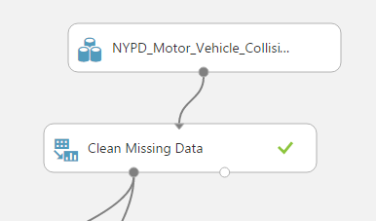
Microsoft Azure Machine Learning Studio / Azure ML
Microsoft currently offers a free cloud based machine learning platform called Azure ML.
Since Azure ML provides drag & drop functionality to process the dataset and perform machine learning operations, we started by uploading the dataset into Azure ML.
Afterwards, we filtered the dataset from 988k rows down to 770k rows that include geocoordinates.
bit.do/hhu-btw2017

Slide 9
Azure‘s Visualize Function
Azure ML contains some ready to use analysis functions:
bit.do/hhu-btw2017

Slide 10
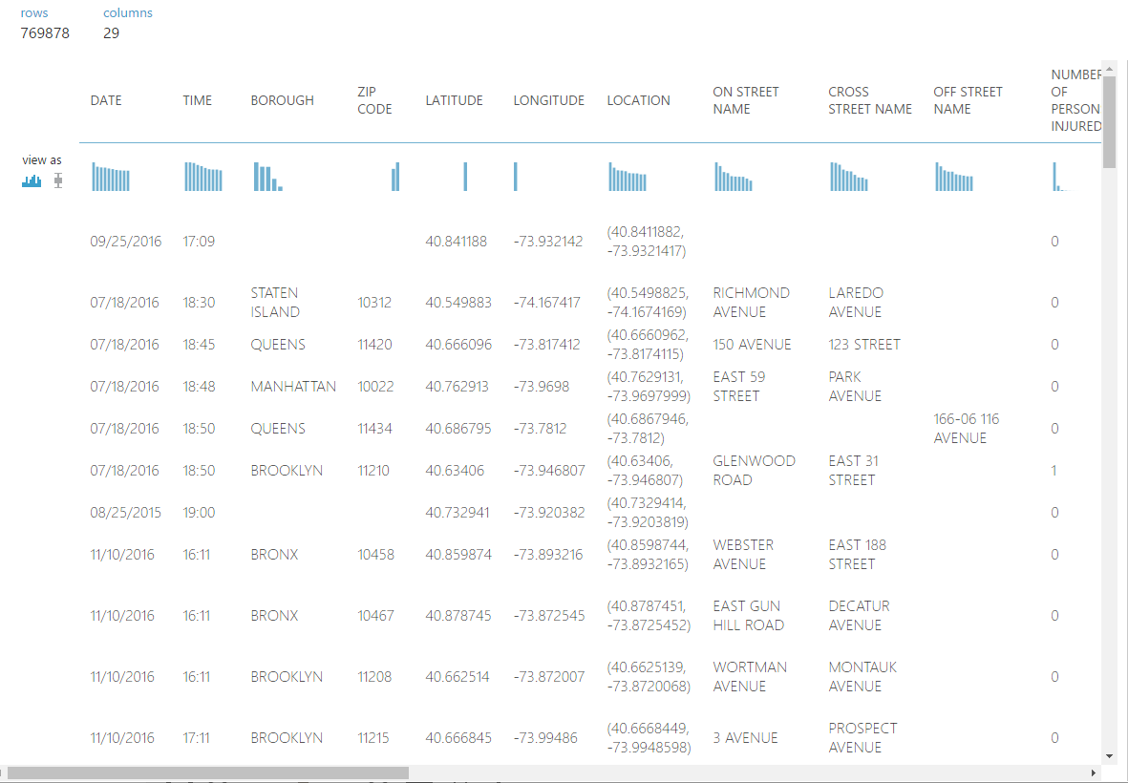
Azure‘s Visualize Function
Azure ML contains some ready to use analysis functions:
bit.do/hhu-btw2017

Slide 11
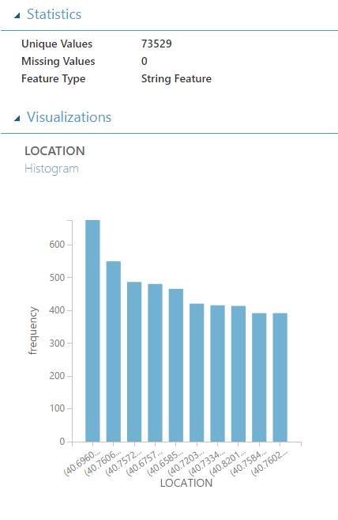
Azure‘s Visualize Function
Attribute location:
We instantly see that:
  there are ~73.5k unique dangerous spots
  that approximately 700 accidents happened at the most dangerous spot
bit.do/hhu-btw2017

Slide 12
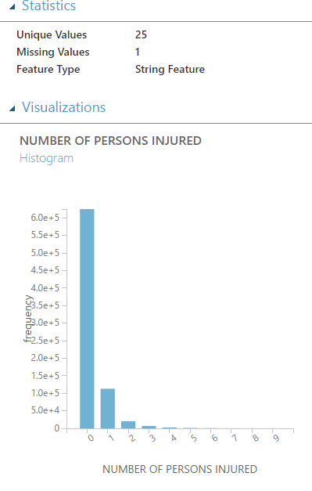
Azure‘s Visualize Function
Attribute persons injured:
We instantly see that:
  no persons were injured in ~650k (84.4%) of the reported accidents
  ~ 13% of the accidents resulted in the injury of one person
bit.do/hhu-btw2017

Slide 13
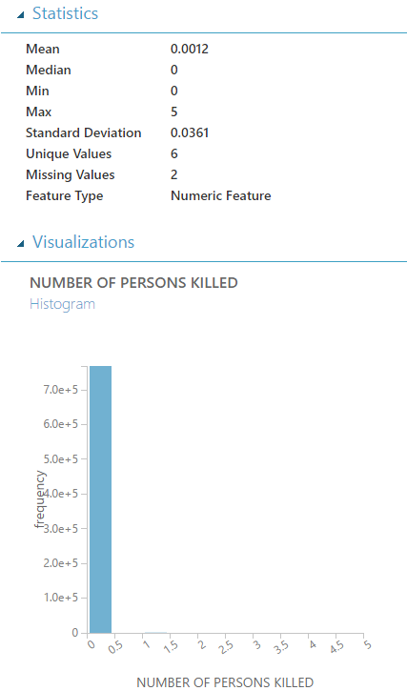
Azure‘s Visualize Function
Attribute persons killed:
We see that:
  Fortunately, deaths of persons are rare!
  The maximum amount of car accident related deaths is 5
bit.do/hhu-btw2017

Slide 14
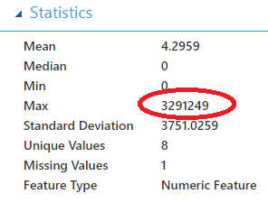
Azure‘s Visualize Function
Attribute number of cyclist injured:
We have outliers!
bit.do/hhu-btw2017

Slide 15
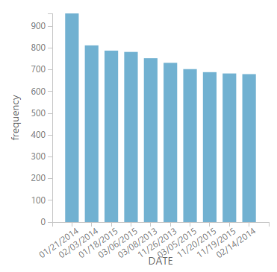
Azure‘s Visualize Function
Attribute date:
We group the accidents by date, sort the number of accidents in descending order and look for possible correlations:
  01/21/2014: blizzard in NYC¹
  02/03/2014: day after Super Bowl 2014
bit.do/hhu-btw2017

Slide 16
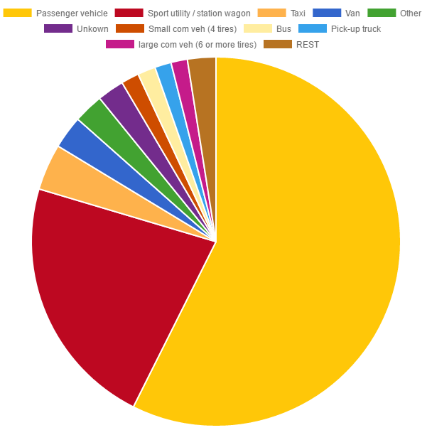
Other Visualizations
Attribute vehicle type code 1:
Passenger vehicles account for most of the accidents.
In about 25% of the accidents, SUVs or station wagons are involved.
0.5% involve motorcycles (not shown in the chart)
0.015% involve bicycles (not shown in the chart)
=> Don‘t drive a car, use a motorcycle or a bicycle instead ;-)
bit.do/hhu-btw2017

Slide 17
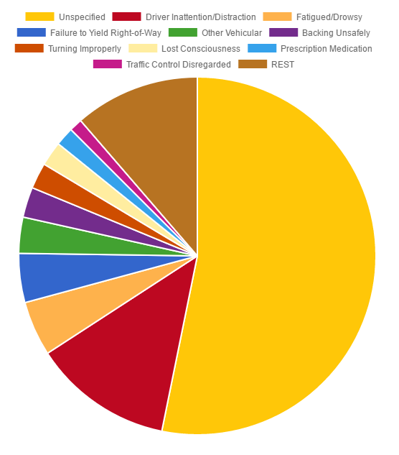
Other Visualizations
Attribute contributing factor vehicle 1:
Regarding the question “What factors influence accidents?”:
  Over 50% of the accidents do not have a contributing factor in their accident report.
  The most common (specified) cause is distraction, followed by being fatigued.
bit.do/hhu-btw2017

Slide 18
Visualization
bit.do/hhu-btw2017

Slide 19
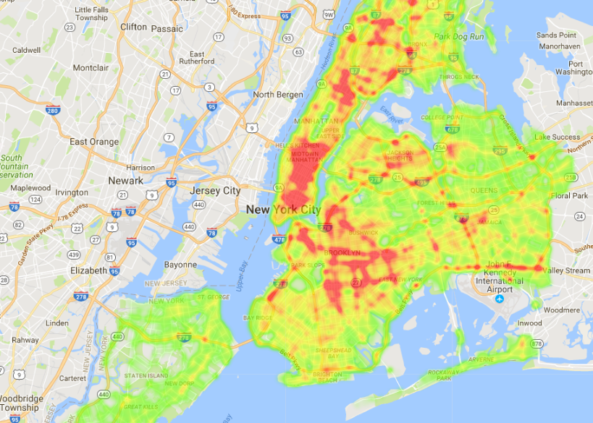
Heatmaps
Let‘s move on to some cooler analysis in the form of visualizing geocoordinates on a map.
We plotted the accidents on a heatmap with Google Maps. The colour of a spot indicates the amount of accidents.
bit.do/hhu-btw2017
Map data © 2017 Google

Slide 20
Heatmaps
The means of transportation (on foot, bycycle, car, or all combined) and the timeframe can be selected.
Let‘s switch to http://btw2017-dsc-hhu.azurewebsites.net and try it out.
bit.do/hhu-btw2017

Slide 21
Heatmaps - Animations
We also include a filter to select a timeframe between a start and an end date.
In order to better understand how the amounts of accidents in a certain area develop over time, we created animations for our heatmap:
  Visualization per day
  Visualization per day and hour
  Visualization per hour
We prepared a video that shows how the amount of accidents for pedestrians develops during the day.
bit.do/hhu-btw2017

Slide 22
„How to travel safely in NYC?“
bit.do/hhu-btw2017

Slide 23
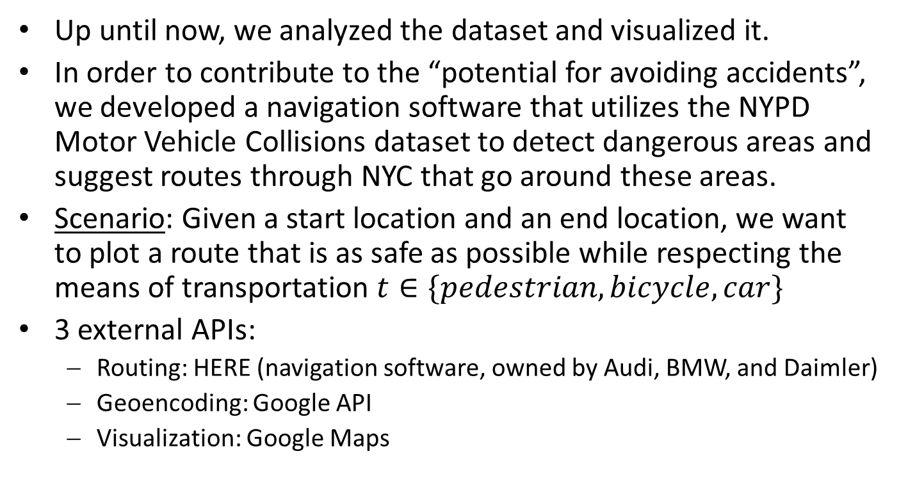
„How to travel safely in NYC?“
Up until now, we analyzed the dataset and visualized it.
In order to contribute to the “potential for avoiding accidents”, we developed a navigation software that utilizes the NYPD Motor Vehicle Collisions dataset to detect dangerous areas and suggest routes through NYC that go around these areas.
Scenario: Given a start location and an end location, we want to plot a route that is as safe as possible while respecting the means of transportation $t∈\{pedestrian, bicycle, car\}$
3 external APIs:
  Routing: HERE (navigation software, owned by Audi, BMW, and Daimler)
  Geoencoding: Google API
  Visualization: Google Maps
bit.do/hhu-btw2017

Slide 24
„How to travel safely in NYC?“
Workflow for the fastest route:
Enter a start and an end location
Choose the means of transportation
Geoencode the entered adresses with Google API (works better than the geoencoding from HERE)
Get the route via the HERE API, JSON response of GPS coordinates
Plot the returned GPS coordinates on Google Maps
bit.do/hhu-btw2017

Slide 25
„How to travel safely in NYC?“
Workflow for a safer route:
Enter a start and an end location
Choose the means of transportation
Geoencode the entered adresses with Google API
Determine dangerous spots based on the dataset within a minimal bounding rectangle of the start and end locations while respecting a personal risk factor (lower values indicate a higher will to take risks)
Get the route via the HERE API while avoiding the dangerous spots
Plot the returned GPS coordinates on Google Maps
bit.do/hhu-btw2017

Slide 26
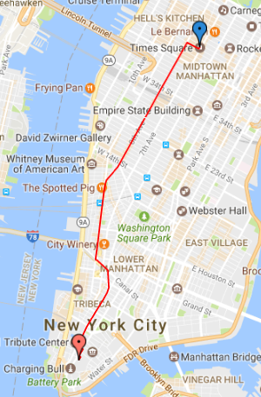
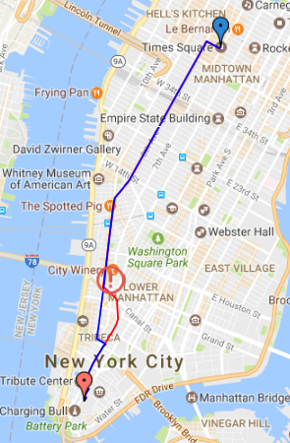
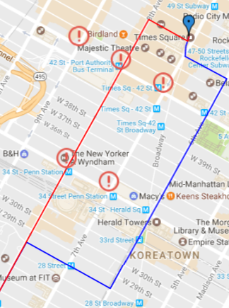
Example 1
Let‘s assume we want to travel from “New York Stock Exchange” to “Times Square” with a bicycle.
bit.do/hhu-btw2017
Map data © 2017 Google

Slide 27
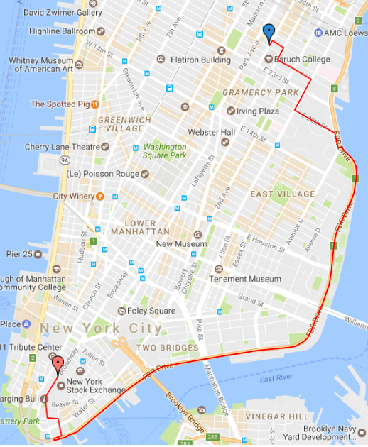
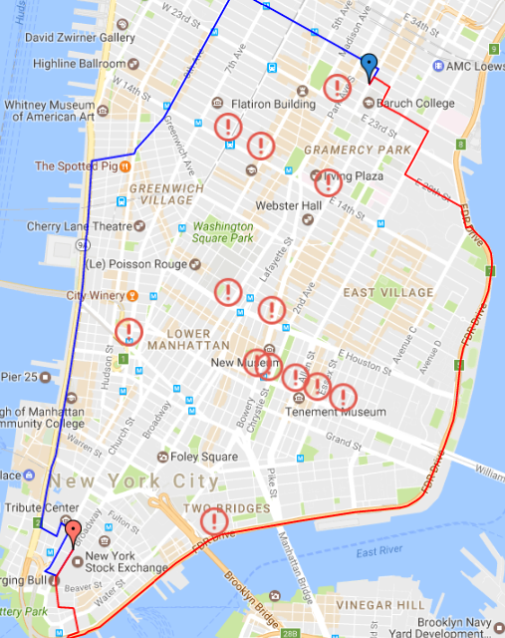
Example 2
Let‘s assume we want to travel from “New York Stock Exchange” to “e 86th street, Lexington avenue” with a car.
fastest route
risk factor = 3
bit.do/hhu-btw2017
Map data © 2017 Google

Slide 28
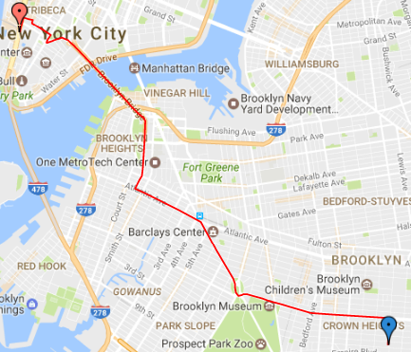
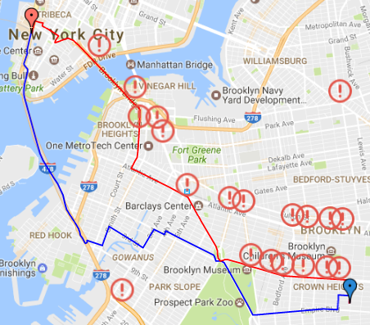
Example 3
Another example that shows that our navigation works outside of Manhattan ;) “One World Trade Center” to “albany ave, prospect pl”
fastest route
risk factor = 5
bit.do/hhu-btw2017
Map data © 2017 Google

Slide 29
Conclusion and Future Work
bit.do/hhu-btw2017

Slide 30
Conclusion & Future Work
Conclusion:
Introducted the goal of the task
Showed descriptive statistics in Azure ML
Visualized the accidents in form of a heatmap
Animated the development of the accidents over time
Demonstrated a solution to possibly make transportation in NYC a little bit safer if our Azure-based solution is actually used by people before starting a trip
Future Work:
Use Azure ML to predict the vehicle type code based on the features in the dataset
Respect temporal aspects and weather conditions, e.g., the current season or events like Super Bowl in the route calculation
bit.do/hhu-btw2017

Slide 31
Thank you for your attention.

Slide 32
References
Screenshots from https://studio.azureml.net
Screenshots from Google Maps: Map data © 2017 Google
bit.do/hhu-btw2017

